Slide 1





WHO ARE JKUATCU DEVS?
Mh! But I have not seen such a team anywhere in JKUATCU documents. Jeff, have you been reading the constitution upside down?
Hey bruh, you know there’s a dev team for JKUATCU?
Ah! Interesting, what’s it all about? What does it do? Where does it meet? Who are it’s members?

Slide 2


START OF THE JOURNEY
So what did we do next? We called in the present members and started official meetings …
Tuesdays; 5-7pm Tech House ground floor

Slide 3






JKUATCU DEVS CHALLENGES
STRUCTURE
SKILL
But when we came, we didn’t know what we were up against.
OUCH!
SERVICES
STANDARDS
DOCUMENTATION

Slide 4




JKUATCU DEVS TROUBLES
Guys its registration again! We need to take care of things.
Arrgh! We need to find our tool-box and fix this thing again!!

Slide 5
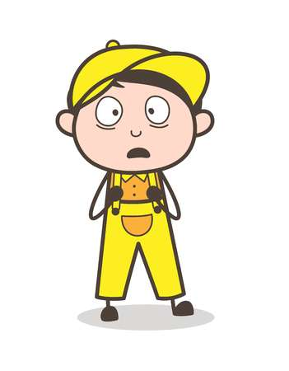
JKUATCU MEMBERS
BS REGISTRATION
PORTAL
SERVICES
The members were left at more confused state…
INFORMATION
APPLICATIONS

Slide 6

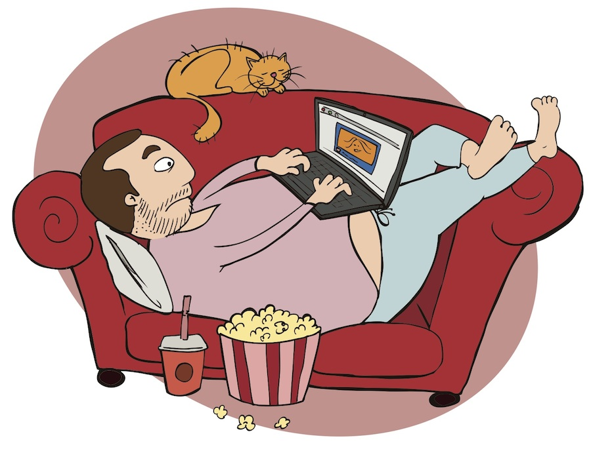
WHERE WE OUGHT TO BE
AN INTERDISCIPLINARY TEAM WORKING TO
ACHIEVE USABILITY
Huh! Back to the code of honor, Laziness!

Slide 7


JKUATCU DEVS LOOK AHEAD
Look Ahead and see the future, a future with;
Better UX
Fluid services
Happier User
Lazy Developers

